Slide 1
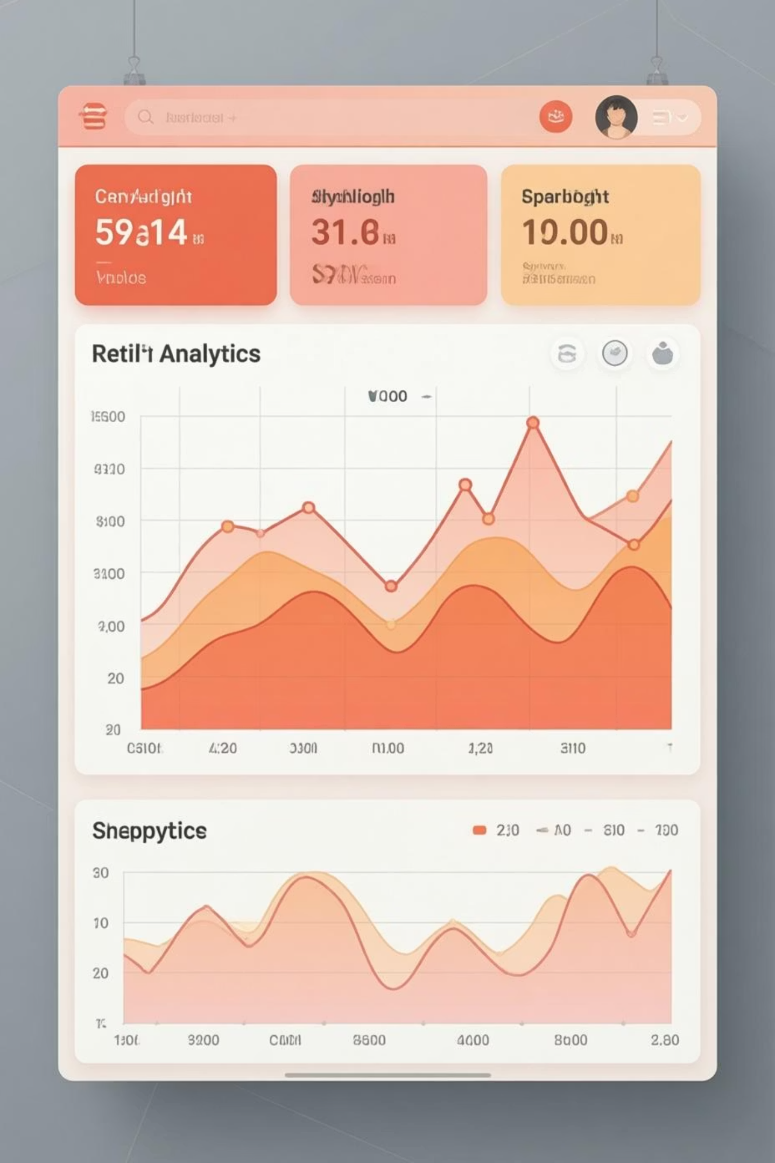
Shopping Trend Analysis
Analyzing customer purchasing behavior to identify revenue drivers using Python, SQL, and Power BI

Slide 2

PROJECT OVERVIEW
Understanding Customer Behavior
Spending Patterns
High Performers
Analyze how customers spend across categories and products
Identify top categories and products driving revenue
Impact Measurement
Data-Driven Insights
Measure effects of discounts, subscriptions, and shipping types
Support strategic business decisions with actionable insights

Slide 3
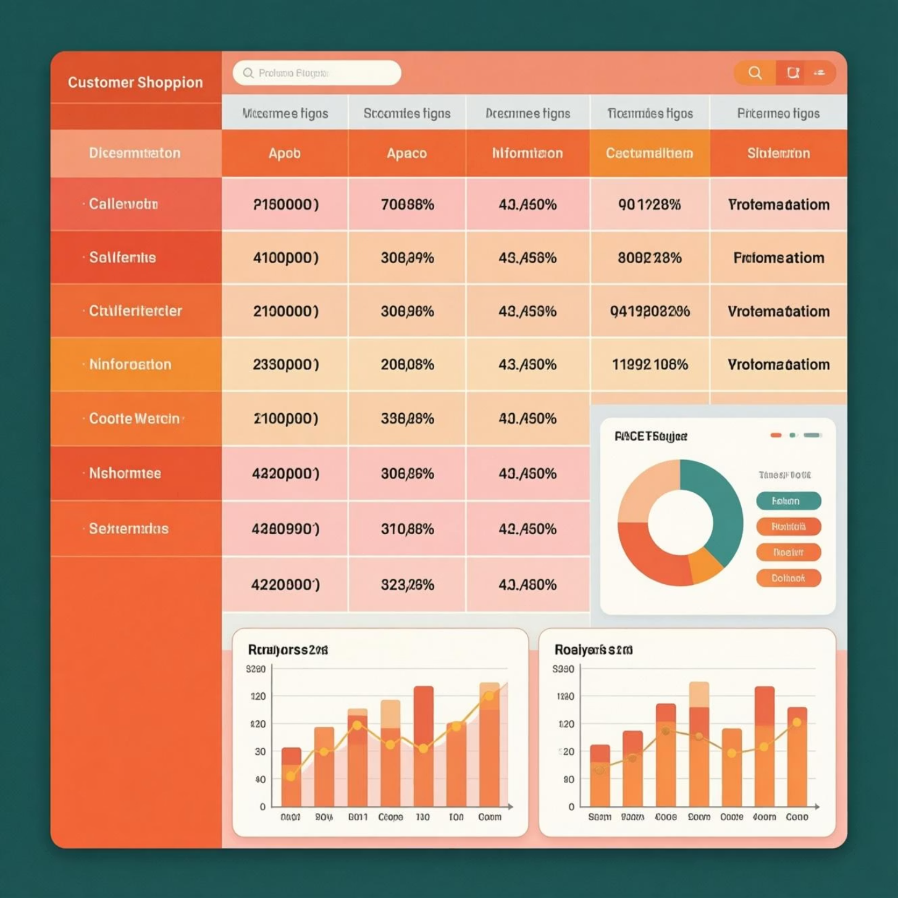
DATASET
Data Foundation
Dataset: shopping_trends.csv
Comprehensive customer data including demographics, purchasing patterns, and engagement indicators.
Key Columns
Customer demographics (ID, gender, age_group)
Product details (category, item_purchased)
Transaction data (purchase_amount, review_rating)
Engagement metrics (subscription_status, previous_purchases)

Slide 4

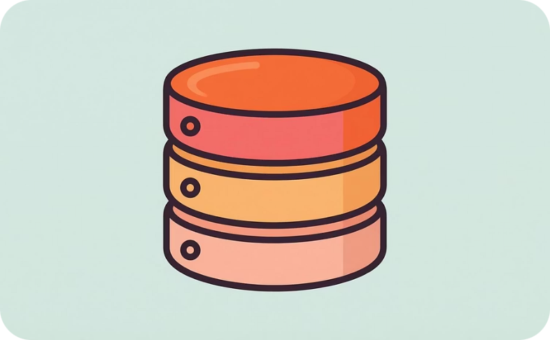
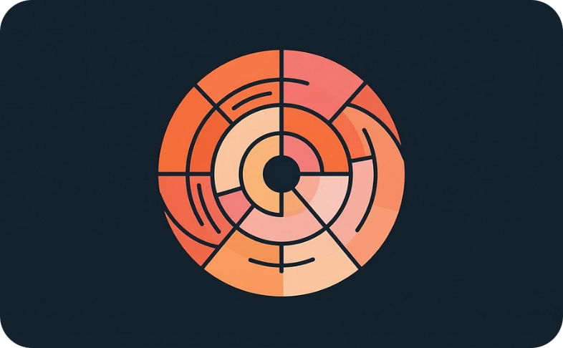
Tools & Technologies
Python
SQL
Power BI
Data cleaning and preparation using Pandas & NumPy
Business queries and structured analysis in MySQL
Data modeling, DAX calculations, and interactive dashboards

Slide 5
DATA PREPARATION
Data Cleaning Process
01
02
Data Loading & Inspection
Quality Checks
Loaded dataset with Pandas, used df.info() and .describe() to check structure and summary statistics
Checked null values with df.isnull(), renamed columns to snake_case for consistency
03
04
Feature Engineering
Data Consistency
Created age_group and purchase_frequency_days columns for deeper analysis
Verified redundant fields, dropped promo_code_used, exported clean dataset for SQL

Slide 6

KEY INSIGHTS
SQL Analysis Highlights
3.75
₹233K
47%
Average Rating
Subscription Revenue
Discount Users
Customer satisfaction score across all products
Customers who applied discounts to purchases
Total revenue from subscribed customers

Slide 7
Revenue Drivers Analysis
Gender Impact
Subscription Power
Shipping Preference
Male customers generate higher total revenue compared to female customers
Subscribed customers show significantly higher average spend and total revenue
Express shipping correlates with higher purchase amounts per transaction
Customer Segmentation
Age Group Performance
New: First-time buyers | Returning: 2-5 purchases | Loyal: 5+ purchases
Middle-age customers drive highest revenue, followed by youth and senior segments

Slide 8

Top Performing Products
Highest Rated
Best Discounts
Jewelry, Blouse, and Dress lead in customer satisfaction scores
Top-rated products also offer competitive discount percentages
Category Leaders
Top 3 products identified per category for targeted marketing
Products with high ratings and strategic discounts drive both customer satisfaction and revenue growth.

Slide 9
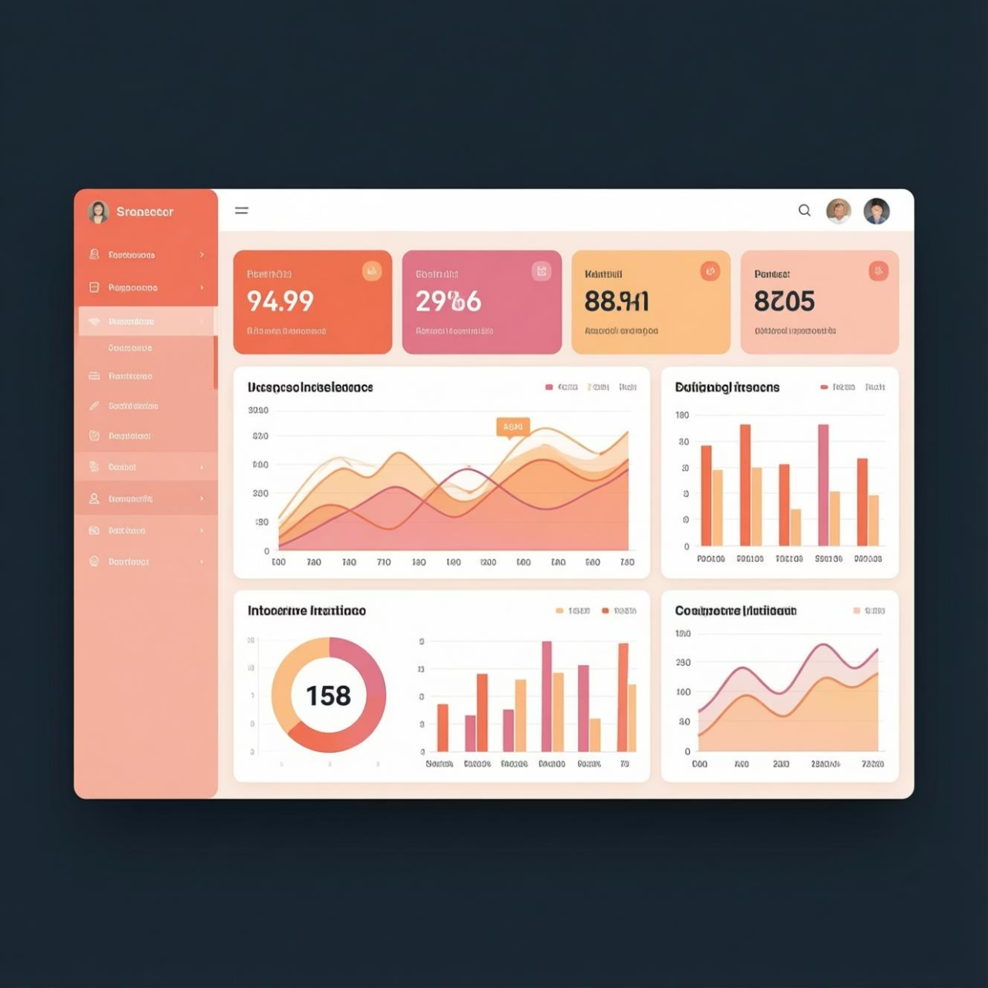
VISUALIZATION
Power BI Dashboard
Main KPIs Tracked
Total Revenue
Number of Customers
Average Order Value (AOV)
Average Review Rating
Visual Components
Donut chart: Subscription status distribution
Bar charts: Category revenue and sales
Column charts: Age group analysis
Interactive slicers for filtering

Slide 10

ACTION PLAN
Business Recommendations
1
Improve Customer Satisfaction
Focus on better packaging and quality checks to push ratings above 4.0 and boost loyalty
2
Boost Subscriptions
Offer exclusive discounts, combo deals, and free shipping to increase subscription rate
3
Age-Based Marketing
Target youth with trendy products and middle-age customers with high-value items
4
Customer Retention
Launch loyalty programs and email marketing campaigns to convert customers into subscribers

